Slide 1



Basic introduction to Survival Analysis with R
Dr. Susan Simmons, IAA

Slide 2
Survival Analysis workshop
Understand survival data
Censoring, survival probability, hazard rate
Create Kaplan-Meier curves (survival curves)
Stratify curves
Test curves
Brief intro to Cox regression models

Slide 3
What is survival Analysis?
In survival analysis, we are interested in the time until an event occurs, or failure time.
Event is a qualitative change that can be tied to a specific point in time.
Originally designed to study the occurrence of death in medical studies – hence survival analysis.
Other names:
Time-to-event analysis
Duration analysis
Failure time analysis
Reliability analysis

Slide 4
“Time-to-event data?
In survival analysis, “time” generally refers to tenure rather than actual calendar time.
The “event” is some specific outcome of interest:
Customer cancel service
Customer make another purchase
Patient develops disease
Logistic regression: “Did it happen?”
Survival analysis: “How long did it take to happen?”

Slide 5
Data Structure
In survival analysis, the target variables is actually two pieces – one continuous and one categorical:
Time: the tenure for an observation (continuous)
Event/status: At the end of that time, what happened? (categorical)
Observation | Time (Tenure) | Status (censor)
1 | 82 | 0
2 | 76 | 1
3 | 84 | 1

Slide 6
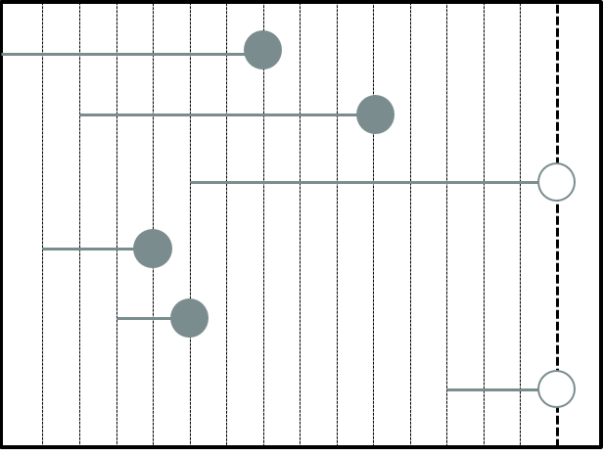
Tenure and Censoring

Slide 7
Tenure and Censoring
Obs Tenure Censor
1 7 1
2 8 1
3 10 0
4 3 1
5 2 1
6 3 0
NOTE: This type of data is called “right-censored” data (most common)

Slide 8

Survival function
Survival function: probability of surviving beyond time t:
Properties:
Always starts at 1 (or 100%).
Never increases.
Bounded below by 0 (or 0%).
Most common method is the Kaplan-Meier curves
$$S\left(t\right)=P\left(T>t\right)$$

Slide 9
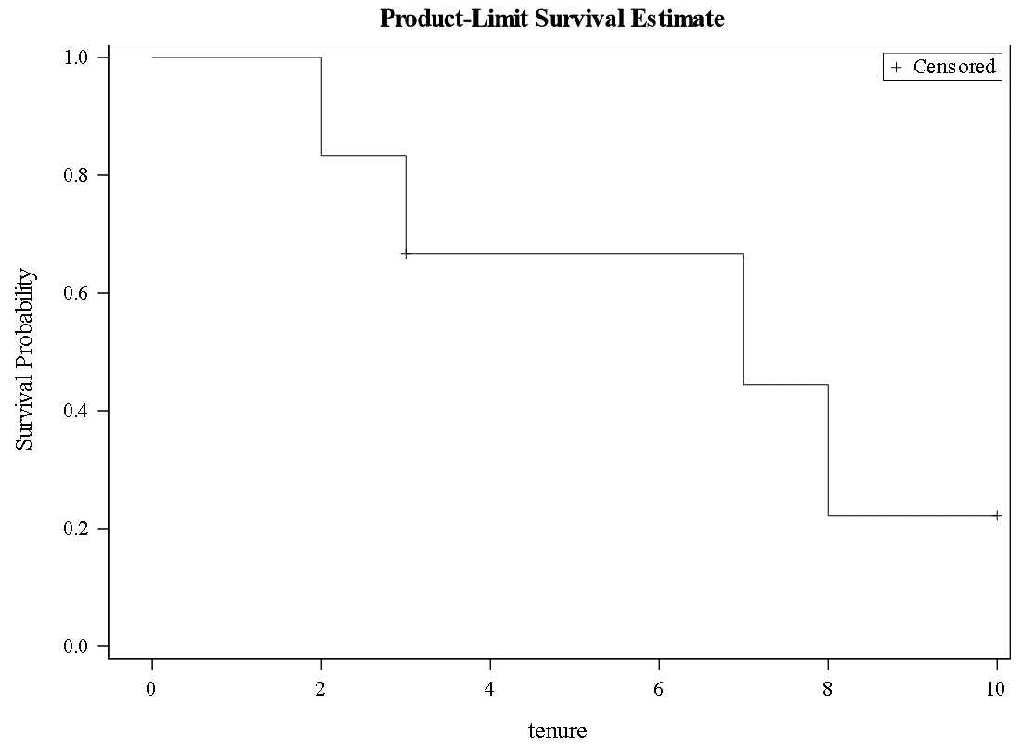
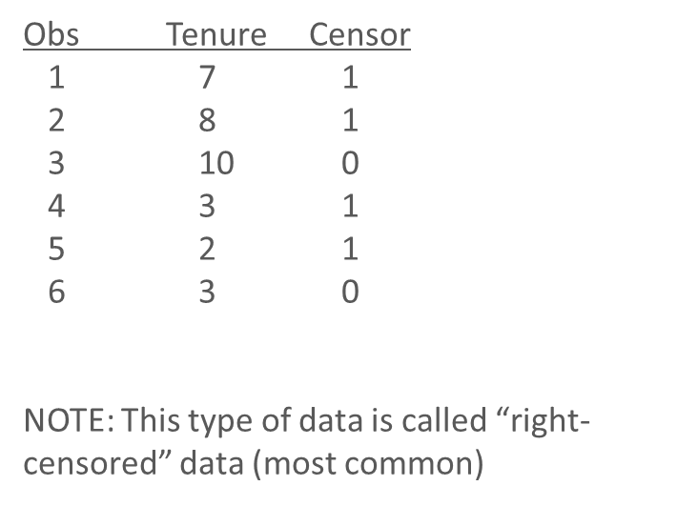
Small data set

Slide 10
Time to use r
You need to have R AND RStudio downloaded (R is the programming language and Rstudio is the IDE…integrated development environment)
In Rstudio, you will need to install the package survival and ggplot2
Command in R is install.packages(“survival”)
Step 3 Title
Step 2 Title
Step 1 Title

Slide 11
Data set
We will be using the lung data set in the R package of survival
This data set is a lung cancer survival data set from the North Central Cancer Treatment group (NCCTG). The performance scores rate how well the patients can perform usual daily activity.
The variables are:
Inst – institution code
Time – survival time in days
Status – censoring status: 1=censored and 2=death (the event)
Age - age in years
Sex - 1 is for male and 2 is for female
Ph.ecog – ECOG performance score: 0=asymptomatic, 1= symptomatic but completely ambulatory, 2= in bed <50% of the day, 3= in bed > 50% of the day but not bedbound, 4 = bedbound
ph.karno - Karnofsky performance score (bad=0-good=100) rated by physician
pat.karno - Karnofsky performance score as rated by patient
meal.cal - Calories consumed at meals
wt.loss - Weight loss in last six months (pounds)

Slide 12
Time to go to R…

Slide 13
resources
R resources:
https://adv-r.hadley.nz/
https://bookdown.org/rdpeng/rprogdatascience/
https://moderndive.com/
https://r-graphics.org/
Survival
https://www.tidyverse.org/blog/2021/11/survival-analysis-parsnip-adjacent/
https://cran.r-project.org/web/packages/survival/vignettes/survival.pdf
http://www.sthda.com/english/wiki/survival-analysis-basics

Slide 14

Thank you!

